Slide 1



SERIOUS EVENT REVIEW
Drop Object- Water Pump Struck Workers Hard Hat
Notice # 24-11541-SEF
Aecon Business Sector: Major Projects East
Project / Location: BNA (Gordie Howe) Canadian Bridge Pier 14
Date of Event: Oct 16th, 2024
Event Type: Lost Time (mild to severe concussion requiring 4 days away from work).

Slide 2
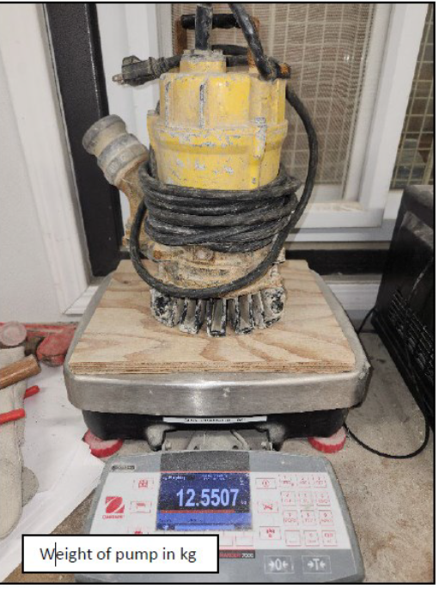
EVENT SUMMARY
An electric 2-inch water pump weighing 26lbs fell 18’4” striking a laborer on the back of the hard hat. The laborer had just descended the ladder to the bottom of the pier tower when the pump struck him on the back of the hard hat. IW was assigned the task of pumping water out of the pier leg from the inside.
The injured worker did not lose consciousness and remained on his feet. His tool belt hung on the power cord at the top of the ladder and when he reached the bottom, he inadvertently pulled the pump from the concrete platform 18' 4" above him.
SIF Rating
Actual: Medium
Potential: High

Slide 3
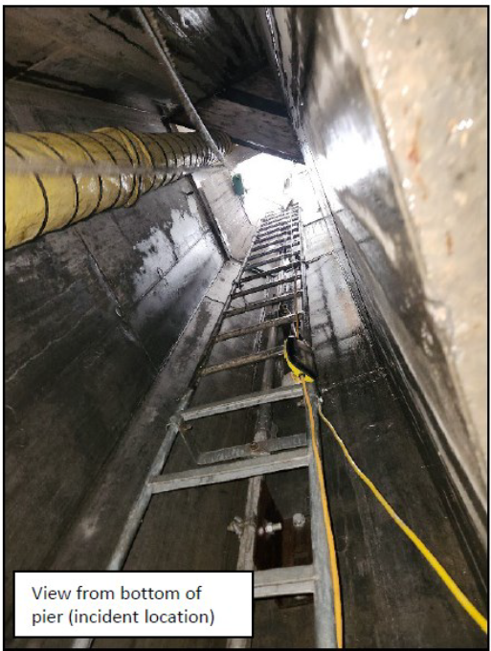
EVENT SUMMARY – SUPPORTING PHOTOS
Location of pump
View and placement of the pump prior to being pulled off the platform. Pump was behind the horizontal scaffold tube which was 5 ¾ inches in height.

Slide 4
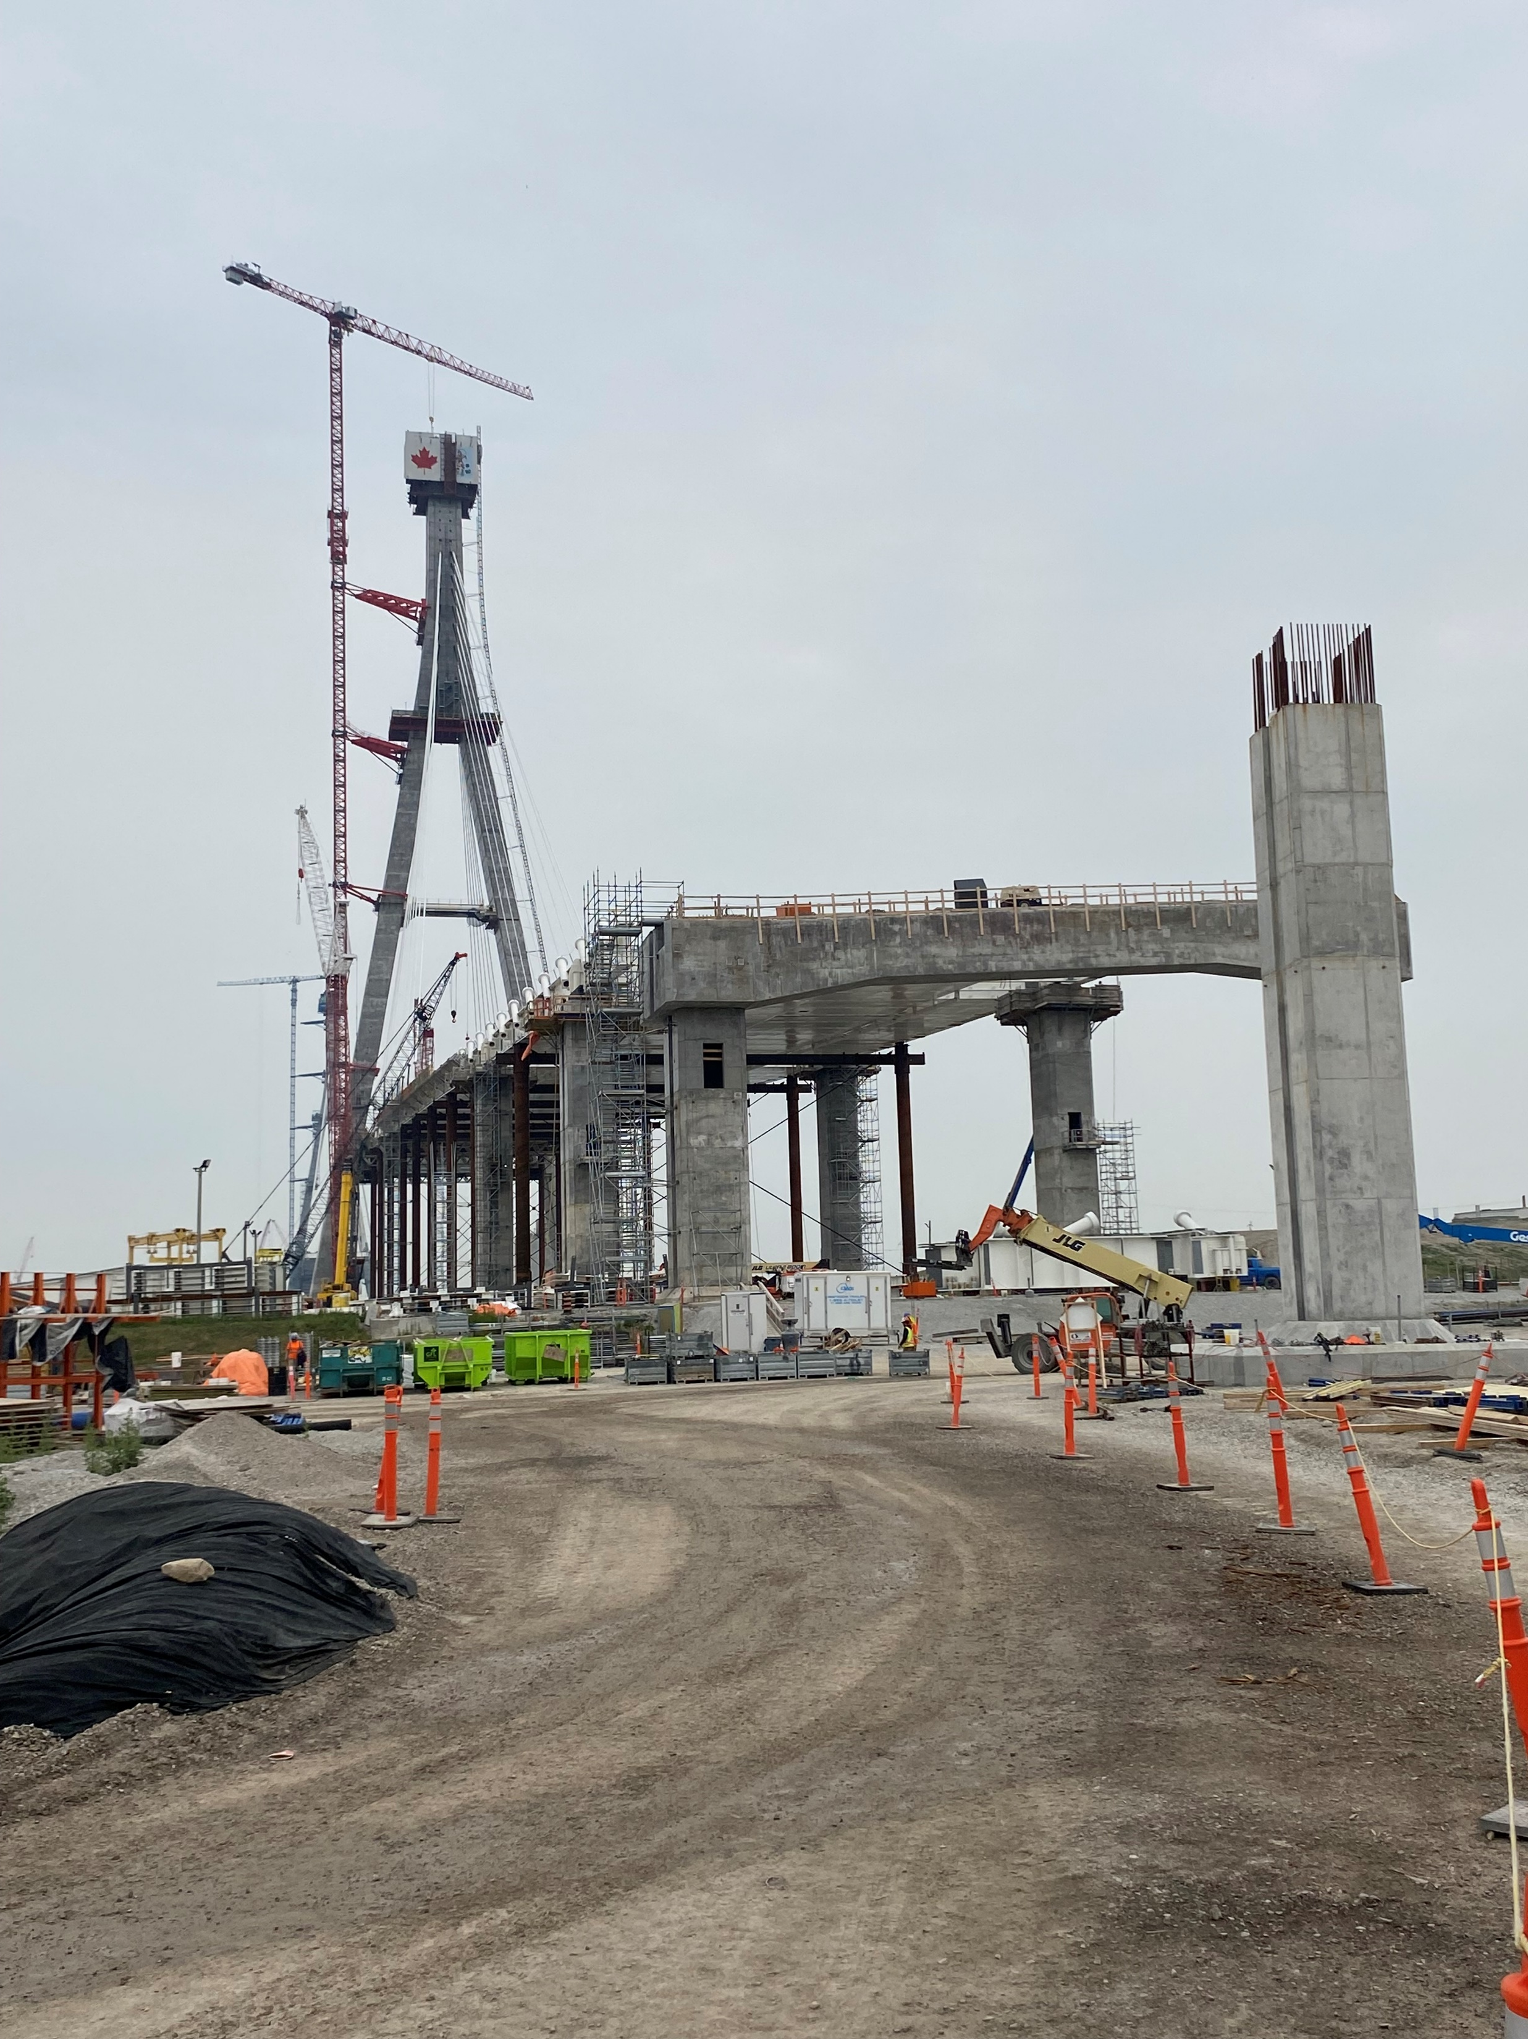
The hard hat involved in the incident is not a BNA issued hard hat but meets the code requirements specified in the BNA Safety Plan.
Hat was worn with the brim to the rear. The hard hat suspension was properly placed in the hard hat (pad to the front and adjuster in the rear)
Example of bridge pier's exterior view

Slide 5
IMPACTS
Actual Impact(s):
Operations stopped and scene frozen for initial investigation. Schedule and production delays in critical path.
IW sent to offsite clinic as a precaution due to damage noted on hard hat as well as weight of pump, distance of drop, and the energy created.
Dropped object audits were conducted inside of all pier legs and main tower internals before activities were able to recommence work both on the US and Canadian sides of the bridge. These reactive efforts of multiple BNA staff is what temporality impacted the schedule.
Worker was taken to an offsite medical clinic and was diagnosed with a mild to severe concussion and placed off work until Oct 23, 2004, due to standard concussion protocols.
Potential Impact(s):
Severe/fatal injuries due to drop object (weight, force, and height). Energy exposure
Project shutdown.
Lost of production, fines, and legislative consequences.
Jeopardizing our reputation and integrity with the trades, unions, and legislative authorities.

Slide 6
CAUSAL FACTORS
Underlying Causes:
Equipment tethers were not being utilized at time of accident inside the piers for water pumps because they were thought not to be necessary.
The water pump was not adequately secured or fastened on the platform pier to prevent a potential drop object hazard.
The only means of dropped object prevention was space and distance from the edge of the platform.
False sense of security that the horizontal tube rail 5 ¾ in height was adequate prevention and protection for dropped objects.
A two-inch pump (pump involved in the incident) was used to remove the bulk of the water but never hoisted out of the pier once it was not required. Adding additional clutter and tools in an already tight work location.
Once most of the water was removed, the pump was relocated to the concrete platform in the center of the pier and a “puddle pump” was put in place to remove the remainder of the water.
The IP was in the process of descending the ladder inside the pier to repositioning the “puddle pump” when he inadvertently pulled the two-inch pump off the platform above.
The two-inch pump was placed behind the horizontal scaffold tubes to prevent it from falling until it was to be removed from the pier. The pump is 13 inches tall with cord attached at the top of the pump. The downward pressure/pull from the cord getting entangled caused the pump to tip over the horizonal rail.
The power cord of the two-inch pump is approximately 2 foot short of the bottom of the pier providing additional tension to the cord.
Immediate Cause
The electric water pump hitting the worker's hard hat.

Slide 7
CORRECTIVE ACTIONS
Initiate a “Process Flow” to prevent dropped objects (pump or other devices)- Platform either; 1. free from loose objects & materials at top, or 2. secured/fastened, or 3. behind physical barricade, or 4. additional means of protection (example) mesh curtain installed. One of these controls must be present.
BNA- Ops & Safety to regularly complete verifications for BNA’s “Safety Absolutes” equivalent to Aecon’s Fatal 8 activity for WAH (PUE- Dropped Object) for compliance. Increased monthly drop object blitzes on this topic until project completion.
BNA craft to wear JV provided hard hat. Aecon staff to wear approved class e, type 2 hard hats with chin straps.
Supervisors and craft to visually assess their task to prevent entanglement with surrounding objects and cords inside the piers.
Immediately remove unnecessary tools and equipment that are not needed inside the pier towers. Include a work sequence in the dewatering plan. If a tool or pump is no longer required, have it removed and relocated to a safe location immediately.
Follow and verify all dropped object prevention SOP’s and requirements developed for BNA project.
Notes:
Corrective Actions:

Slide 8
TOGETHER WE ARE SAFER.

